Slide 1
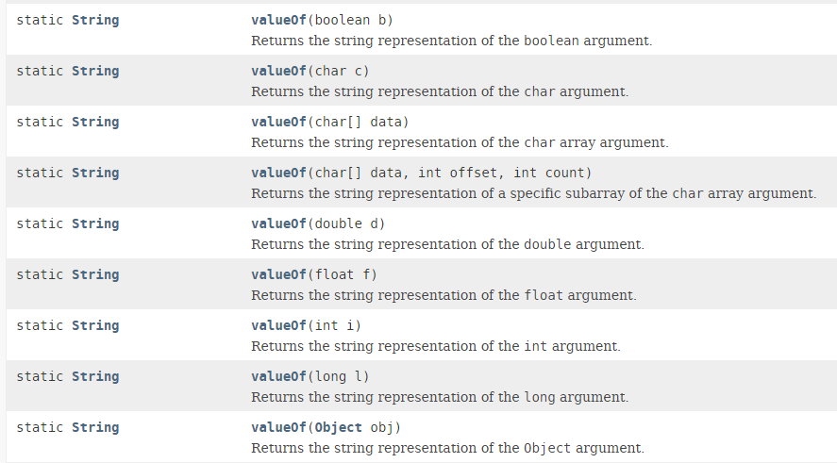
Java valueOf Method

